Slide 1
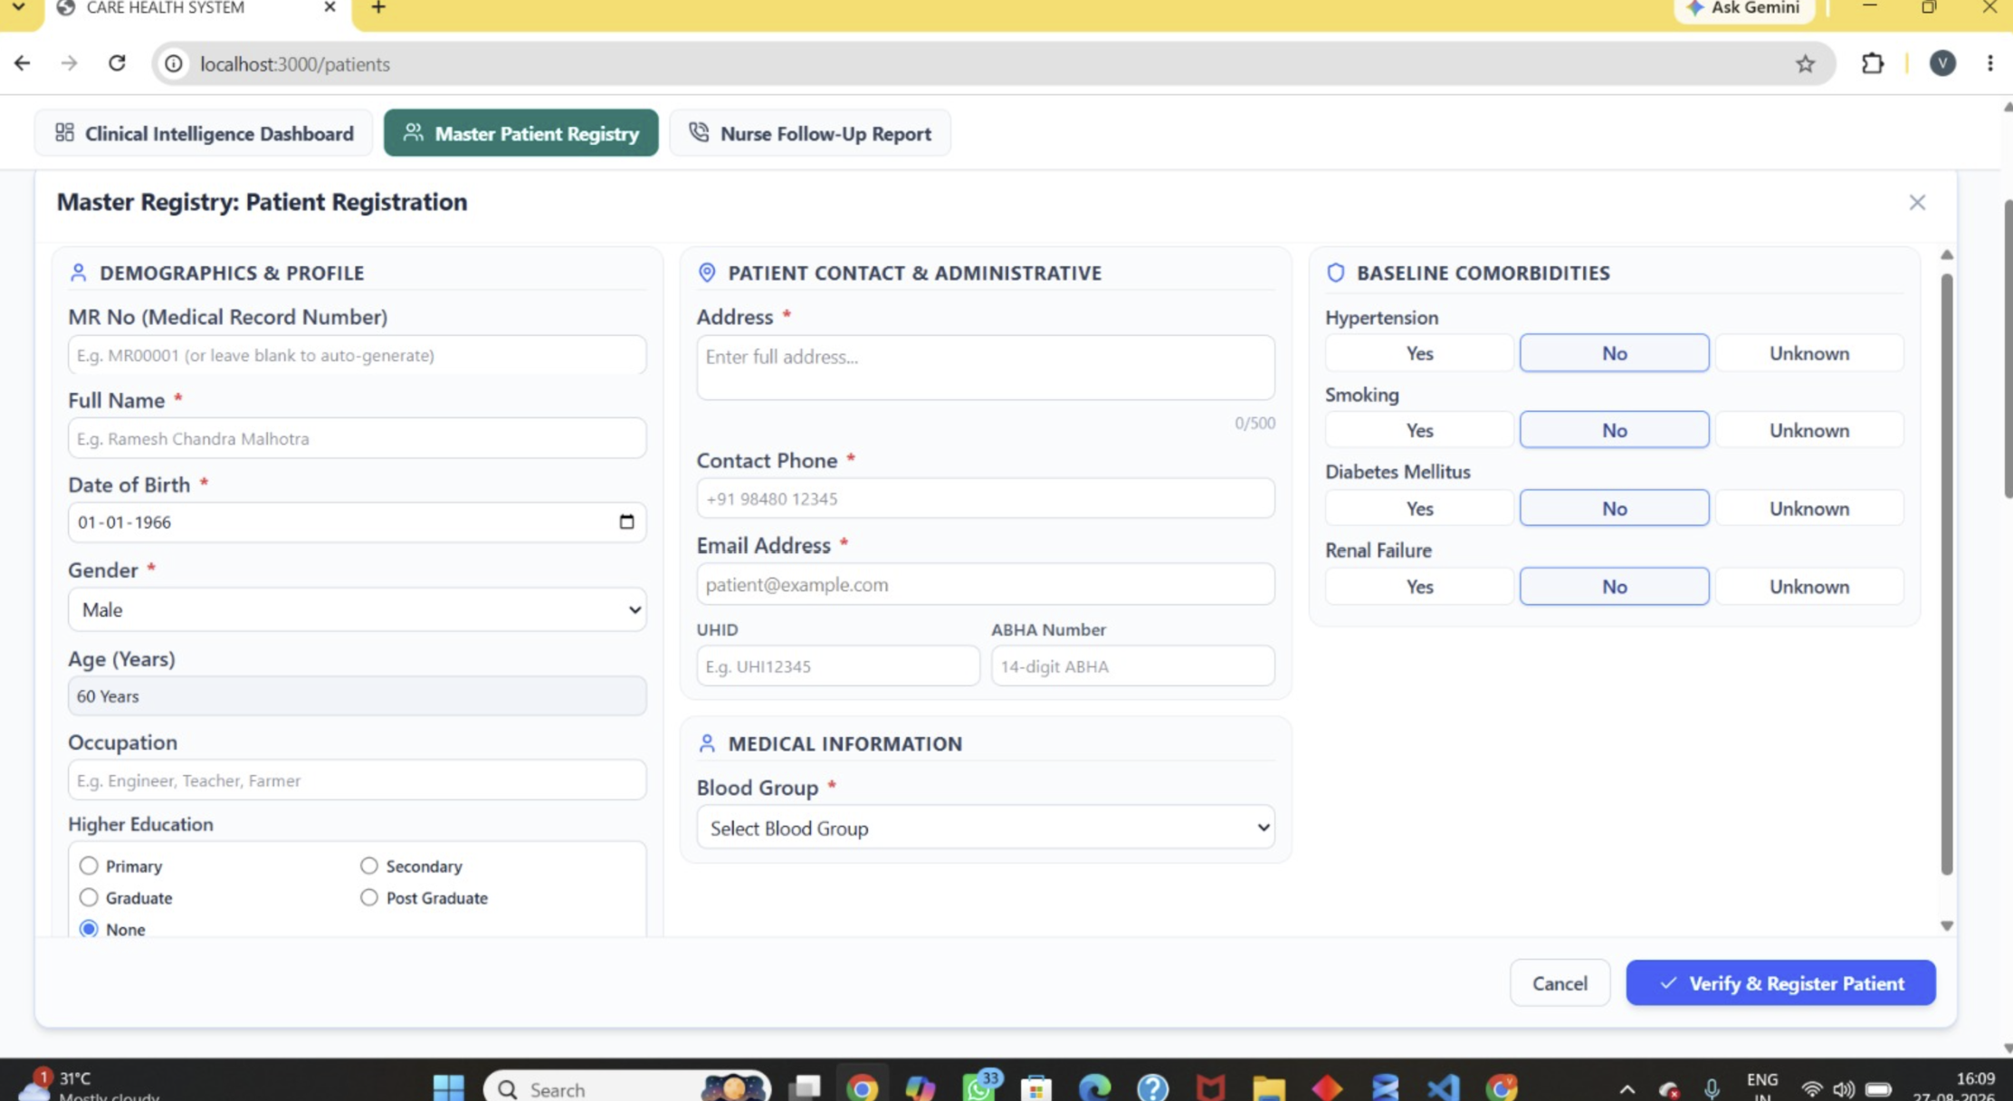

Slide 2
Layer 2 - Candidate generation
If deterministic matching finds nothing, don't compare against every patient.
Index Patient Table to optimize
High Confidence >=95%
Indicate Existing patient with confidence score to user with the message “Duplicate patient found”
Upon select populate all the fields from patient master
[View Patient List with Matching score]
Layer 1 - Deterministic matching
Existing Patient Identified
Give the details of the patient and let user select
Upon select populate all the fields from patient master
[View Patient]
Exact Match Rule Engine
MR. No
ABHA
UHID
Phone
Email
DOB + Name + Phone + Pin code
Yes
Review Required >=80%
Show patients list where confidence level is between 95% and 80%
The list should show patient name along with confidence score
Upon select populate all the fields from patient master
[View Patient List with Matching score]
Weighted Score / Confidence Score Engine
Layer 3 — Fuzzy Match Engine
For each candidate, calculate individual field scores.
Mr. No – Only if it’s not autogenerated – Varshitha to verify
Generate Patient List (Fuzzy Match)
DOB / Birth Year
Phone
Name
Pin Code
Address
Gender
High Confidence <80%
Register New Patient
No
Display Patient List Format:
Possible Existing Patients
1. Ramesh Chandra Rathi; MR000123
Match: 96.8%
2. Ramesh Kumar Rathi; MR001872
Match: 91.4%
3. Ramesh C Rathi; MR002341
Match: 83.7%

Slide 3
Scoring Model
Suggested Model
Field | Weight
ABHA | 25%
UHID | 20%
Phone | 15%
DOB | 15%
Name | 15%
Address | 5%
Email | 3%
Gender | 2%
Strong positive evidence
ABHA exact match +100
UHID exact match +100
Phone exact match +40
DOB exact match +30
Name similarity > 0.90 +25
Address similarity > 0.85 +10
Gender exact +5
Strong negative evidence
DOB conflict -40
Gender conflict -20
Phone conflict -15
ABHA conflict -100
Don't simply calculate this as a normal weighted average when fields are missing.
For example, if ABHA isn't provided, its 25% should not automatically become a mismatch.
Use:
Score = Σ(weight × field_score × field_available)/ Σ(weight × field_available)
So missing data is neutral, not negative.
Final Score = positive evidence - conflict penalties

Slide 4
Field Classification
Mr. No is entered by the Nurse? It can not be autogenerate – Varshitha to verify
Field in your form | Identity strength | Use in matching? | Recommended approach
MR No. | Very High | ✅ | Exact
ABHA Number | Very High | ✅ | Exact
UHID | Very High | ✅ | Exact
Contact Phone | High | ✅ | Exact + normalized
Full Name | High | ✅ | Fuzzy
Date of Birth | Very High | ✅ | Exact / partial
Gender | Medium | ✅ | Exact
Email | High | ✅ | Exact + fuzzy
Address | Medium | ✅ | Component-level fuzzy
Occupation | Low | ⚠️ | Supporting evidence
Education | Low | ⚠️ | Supporting evidence
Blood Group | Low/Medium | ⚠️ | Validation only
Hypertension | Very Low | ❌ | Do not use for identity
Smoking | Very Low | ❌ | Do not use
Diabetes | Very Low | ❌ | Do not use
Renal Failure | Very Low | ❌ | Do not use

Slide 5
Database Table
Master Patient table
Matching/search table
patient_match_audit
PATIENT
──────────────────────────────
patient_id PK
mr_no UNIQUE
full_name
date_of_birth
gender
phone
email
Address (** break it down to address component)
Uhid Unique
abha_number Unique
occupation
education
blood_group
Patient_status_Master (** New Field)
merged_into_patient_id (** if Patient status is Merged)
created_at
updated_at
PATIENT_IDENTITY_INDEX
──────────────────────────────
patient_id PK/FK → patient.patient_id
normalized_name
name_phonetic
normalized_phone
phone_hash
normalized_email
email_hash
normalized_address
dob
dob_year
gender
normalized_uhid
uhid_hash
normalized_abha
abha_hash
dob
dob_year
gender
pincode
normalize_address
District
Pin code
created_at
updated_at
patient_match_audit
────────────────────────────────────
audit_id Autogenerate
patient_id PK/FK
candidate_patient_id PK
action
System Decision (**Explained in Decision value master set)
User Decision (**Explained in Decision value master set)
overall_score
field_scores
reasons
algorithm_version
created_by
created_at
PATIENT
│
│ patient_id
▼
PATIENT_IDENTITY_INDEX
│
│ candidate_patient_id
▼
PATIENT_MATCH_AUDIT
Break Address Field to:
House / Flat No
Street / Locality
Village / Town
Block
District
State
Pincode
Patient_status_Master
ACTIVE
INACTIVE
MERGED
DECEASED
DUPLICATE

Slide 6
Sample Data
Actual patient information
source-of-truth table
Patient Master :
patient_id | mr_no | full_name | DOB | gender | phone | UHID | ABHA
P000001 | MR000001 | Ramesh Chandra Malhotra | 1966-01-01 | Male | +91 9876543210 | UHID123456 | 12345678901234
P000002 | MR000002 | Sunita Devi | 1972-06-15 | Female | +91 9988776655 | UHID123457 | 22345678901234
P000003 | MR000003 | Mohammad Imran Khan | 1980-11-20 | Male | +91 9123456789 | UHID123458 | NULL
patients.patient_id
│
│ 1 : 1
▼
patient_identity_index.patient_id
patient_identity_index — matching version
Normalized/searchable identity attributes
The same patients exist here, but the values are transformed specifically for matching.
patient_id | normalized_name | normalized_phone | normalized_email | normalized_uhid | normalized_abha | DOB | gender | pincode
P000001 | ramesh chandra malhotra | +919876543210 | ramesh.malhotra@gmail.com | UHID123456 | 12345678901234 | 1966-01-01 | Male | 226001
P000002 | sunita devi | +919988776655 | sunita.devi@gmail.com | UHID123457 | 22345678901234 | 1972-06-15 | Female | 226024
P000003 | mohammad imran khan | +919123456789 | NULL | UHID123458 | NULL | 1980-11-20 | Male | 225001
patients.patient_id
│
│ 1 : N
▼
patient_match_audit.patient_id
patient_match_audit — what happened during matching
History of matching decisions
This table records the identity-resolution event.
audit_id | candidate_patient_id | action | decision | score | created_by
A000001 | P000001 | VERIFY | HIGH_CONFIDENCE_MATCH | 97.4 | nurse_001
A000002 | P000002 | VERIFY | REVIEW_REQUIRED | 88.6 | nurse_002
A000003 | P000003 | CONFIRM_MATCH | CONFIRMED_SAME_PATIENT | 96.1 | nurse_003
patients.patient_id
│
│ 1 : N
▼
patient_match_audit.patient_id

Slide 7
Matching hierarchy
LEVEL 1
Mr. No
ABHA
UHID
↓
LEVEL 2
Phone
Email
↓
LEVEL 3
DOB
Gender
↓
LEVEL 4
Name
Address
↓
FINAL
Weighted confidence score
patient | patient_identity_index
Source of truth | Search/matching optimization
Human-readable data | Normalized data
Clinical/admin application | Duplicate detection
Original values | Transformed values
Used by registry | Used by matching engine

Slide 8
Decision Value Master
Decision value | Meaning | When used
HIGH_CONFIDENCE_MATCH | Strong evidence that the candidate is the same patient | Score ≥ 95%, subject to conflict rules
REVIEW_REQUIRED | Possible match, but human verification is required | Score 80–94.99%
NO_LIKELY_MATCH | No sufficiently strong existing patient found | Score < 80%
CONFIRMED_SAME_PATIENT | User confirms candidate is the same patient | Nurse/authorized user selects Same Patient
CONFIRMED_DIFFERENT_PATIENT | User confirms candidate is not the same patient | Nurse/authorized user selects Different Patient
MATCH_REJECTED | Candidate was explicitly rejected during review | User rejects a particular candidate
MATCH_NOT_REVIEWED | Candidate was generated but user has not reviewed it yet | Workflow remains pending
MANUAL_MATCH | Authorized user manually selects an existing patient | Fuzzy engine did not produce a satisfactory match
ERROR | Matching process could not be completed | Technical/data-processing error
system_decision | user_decision | final_decision
HIGH_CONFIDENCE_MATCH | CONFIRMED_SAME_PATIENT | USE_EXISTING_PATIENT
REVIEW_REQUIRED | CONFIRMED_SAME_PATIENT | USE_EXISTING_PATIENT
REVIEW_REQUIRED | CONFIRMED_DIFFERENT_PATIENT | CREATE_NEW_PATIENT
NO_LIKELY_MATCH | NULL | CREATE_NEW_PATIENT
REVIEW_REQUIRED | MATCH_NOT_REVIEWED | PENDING_REVIEW
NO_LIKELY_MATCH | MANUAL_MATCH | USE_EXISTING_PATIENT

Slide 9
Technology Stack
Frontend
React / existing web application
↓
Patient Identity Resolution Service
Python
│
├── Weighted scoring
▼
PostgreSQL
│
├── patients_master
└── patient_identity_index
└── patient_match_audit
│
▼
Optional at scale
OpenSearch / Elasticsearch
Registration API Flow
POST /patients/verify
↓
Identity resolution
↓
Decision
↓
User confirmation
↓
POST /patients/register
Based on Form Recommended Combination : Mr. No/ABHA/UHID → phone/DOB → name/address fuzzy matching

